Slide 1
MLUG Challenge – Lizard Lunch 5/8/20
By Leah Edwards

Slide 2
Agenda
The problem
Maths
Approaches

Slide 3
The Problem
I went to the supermarket to get some beers for the Euros final and my bill came to £11.99. With the money detailed in this excel spreadsheet, how many combinations are there that make up the exact change to pay my bill?
Coin/Note | Quantity | Sub Total
£ 10.00 | 1 | £ 10.00
£ 5.00 | 1 | £ 5.00
£ 2.00 | 4 | £ 8.00
£ 1.00 | 5 | £ 5.00
£ 0.50 | 3 | £ 1.50
£ 0.20 | 6 | £ 1.20
£ 0.10 | 4 | £ 0.40
£ 0.05 | 3 | £ 0.15
£ 0.02 | 10 | £ 0.20
£ 0.01 | 5 | £ 0.05
Total |  | £ 31.50

Slide 4
Questions
Does it matter which coin you use?
How will I prove that the answer is correct?

Slide 5
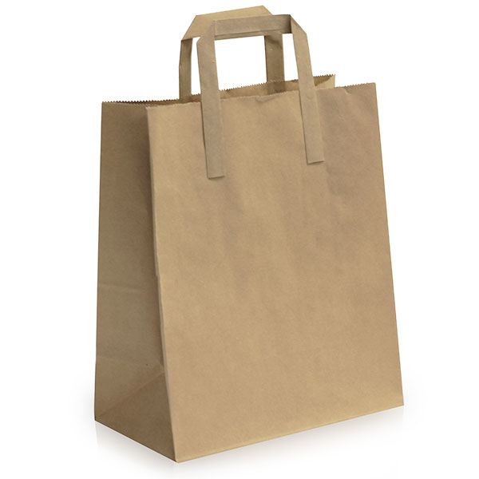
Maths lesson
Pick 2 balls out of the bag.
Order doesn’t matter
A&B, A&C, A&D,
B&C, B&D,
C&D
4C2 = 6
A
B
C
D

Slide 6
Maths lesson
Pick 2 balls out of the bag.
Order does matter
AB, AC, AD,
BA, BC, BD,
CA, CB, CD,
DA, DB, DC
4P2 = 12
Permutations vs combinations
A
B
C
D

Slide 7
1) Brute force solution?
Coin/Note | Quantity
£ 10.00 | 1
£ 5.00 | 1
£ 2.00 | 4
£ 1.00 | 5
£ 0.50 | 3
£ 0.20 | 6
£ 0.10 | 4
£ 0.05 | 3
£ 0.02 | 10
£ 0.01 | 5
Total | 42
Can we check each permutation?
We have 42 coins. For each coin, we have 2 options: use it or don’t use it.
→2⁴² potential permutations that we could make = 4.4x10¹² i.e. 4.4 trillion.
000000000000000000000000000000000000000001

Slide 8
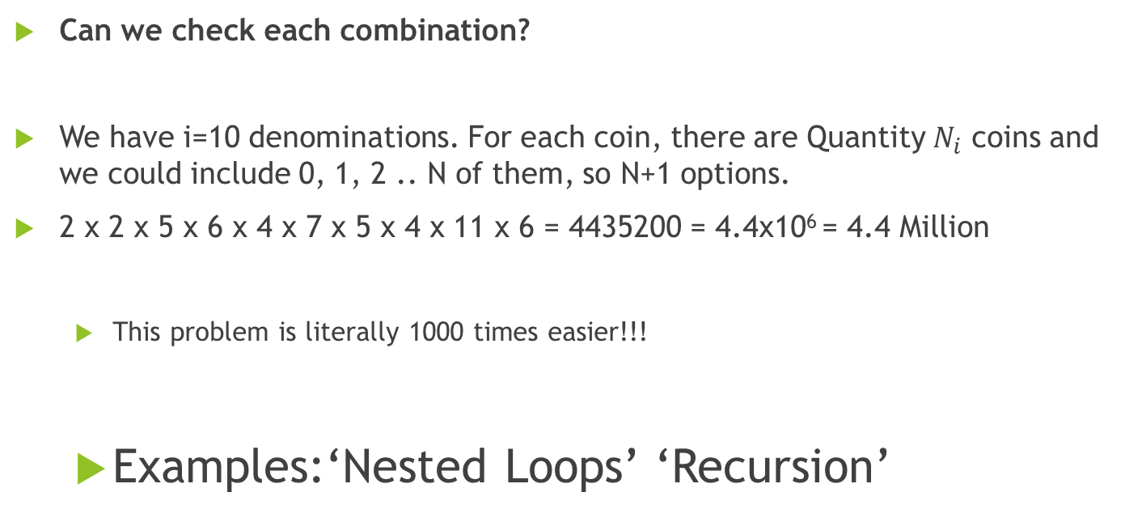
1) Brute force solution?
Coin/Note | Quantity
£ 10.00 | 1
£ 5.00 | 1
£ 2.00 | 4
£ 1.00 | 5
£ 0.50 | 3
£ 0.20 | 6
£ 0.10 | 4
£ 0.05 | 3
£ 0.02 | 10
£ 0.01 | 5
Can we check each combination?
We have i=10 denominations. For each coin, there are Quantity $N_{i}$ coins and we could include 0, 1, 2 .. N of them, so N+1 options.
2 x 2 x 5 x 6 x 4 x 7 x 5 x 4 x 11 x 6 = 4435200 = 4.4x10⁶ = 4.4 Million
This problem is literally 1000 times easier!!!
Examples:‘Nested Loops’ ‘Recursion’
Notes:
Didn’t even bother doing this

Slide 9
Optimisations
Conditional terminal
Single loop
Recursion

Slide 10
2) Brute force solution… with a twist
Order coins in wallet from largest to smallest
Add 1 coin at a time to the total, starting with smallest
Once total bill is reached, *do something*

Slide 11
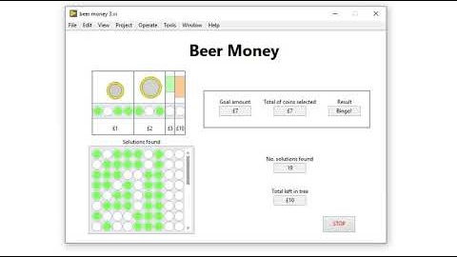
Simplification
Make £7 using the following coins.
£10 x 1
£5 x 1
£2 x 3
£1 x 4

Slide 12
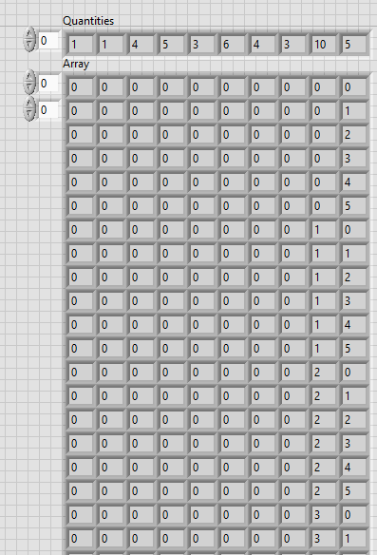
3) Quotient remainder solution
Why are the other solutions better?
Notes:
loops

Slide 13
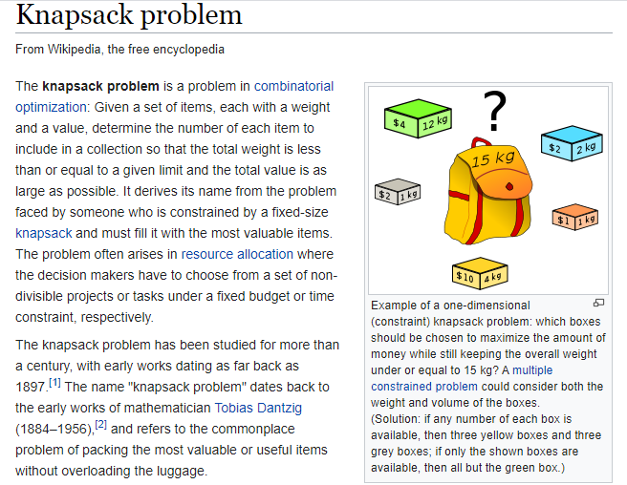
The Knapsack problem
https://en.wikipedia.org/wiki/Knapsack_problem
Notes:
https://en.wikipedia.org/wiki/Knapsack_problem

Slide 14
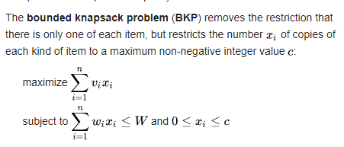
Notes:
Weights are money

Slide 15
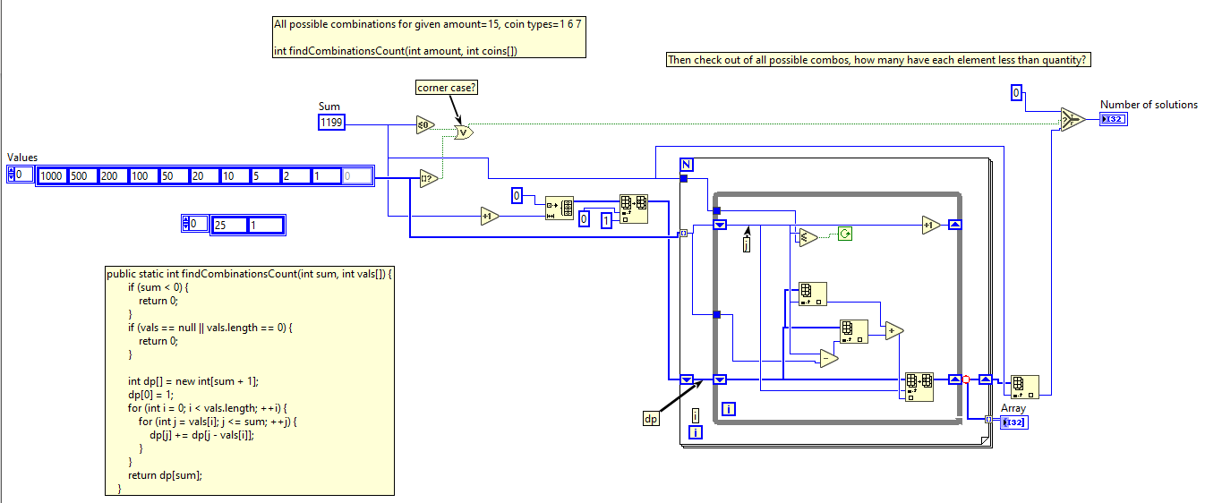


Interesting subproblem…
Find the number of possible combinations if you had INFINITE number of each coins in your wallet.

